Slide 1
University of Computer Study (Pyay)
CS-2254 JavaScript 2022-2023 Academic Year
Group (I)
Suprevised By Daw Aye Aye Theint

Slide 2
YaungNi Blood Donation
Let’s start our presentation!

Slide 3
Members
Ma Khin Thiri Mon 2CS-40
Ma Hsu Myat Mon Kyaw 2CS-48
Ma Khine Lwin Thaw 2CS-39

Slide 4
Contents
01
02
03
04
05
Member Lists
Abstract
Introduction
06
Objectives
Implementation
Conclusion

Slide 5
Abstract
The objective of this application is to developing an online Blood Donation Information.
Our YaungNi Website is to create an e-formation about the donar and organization that are related to donating the blood.
This website is used for maintain whole information about donors,receivers,
camps.

Slide 6
Introduction
YaungNi refers to a practice where people donate their blood to people so it helps them with their health problems. Blood is one of the most essential fluids of our body that helps in the smooth functioning of our body. If the body loses blood in excessive amounts, people to get deadly diseases and even die. Thus, we see how blood donation is literally life-saving which helps people. It is also a sign of humanity that unites people irrespective of caste,creed,religion and more.

Slide 7
Objectives
To collect data about donors and seekers who are interested in donating blood or who require it.
To help patients survive surgeries, cancer treatment, chronic illnesses and traumatic injuries.
To find nearby blood camp drives,blood banks,schedule appointments and contacts.
We intend to the people who live in Pyay to get a happier and longer life.

Slide 8

Implementation

Slide 9
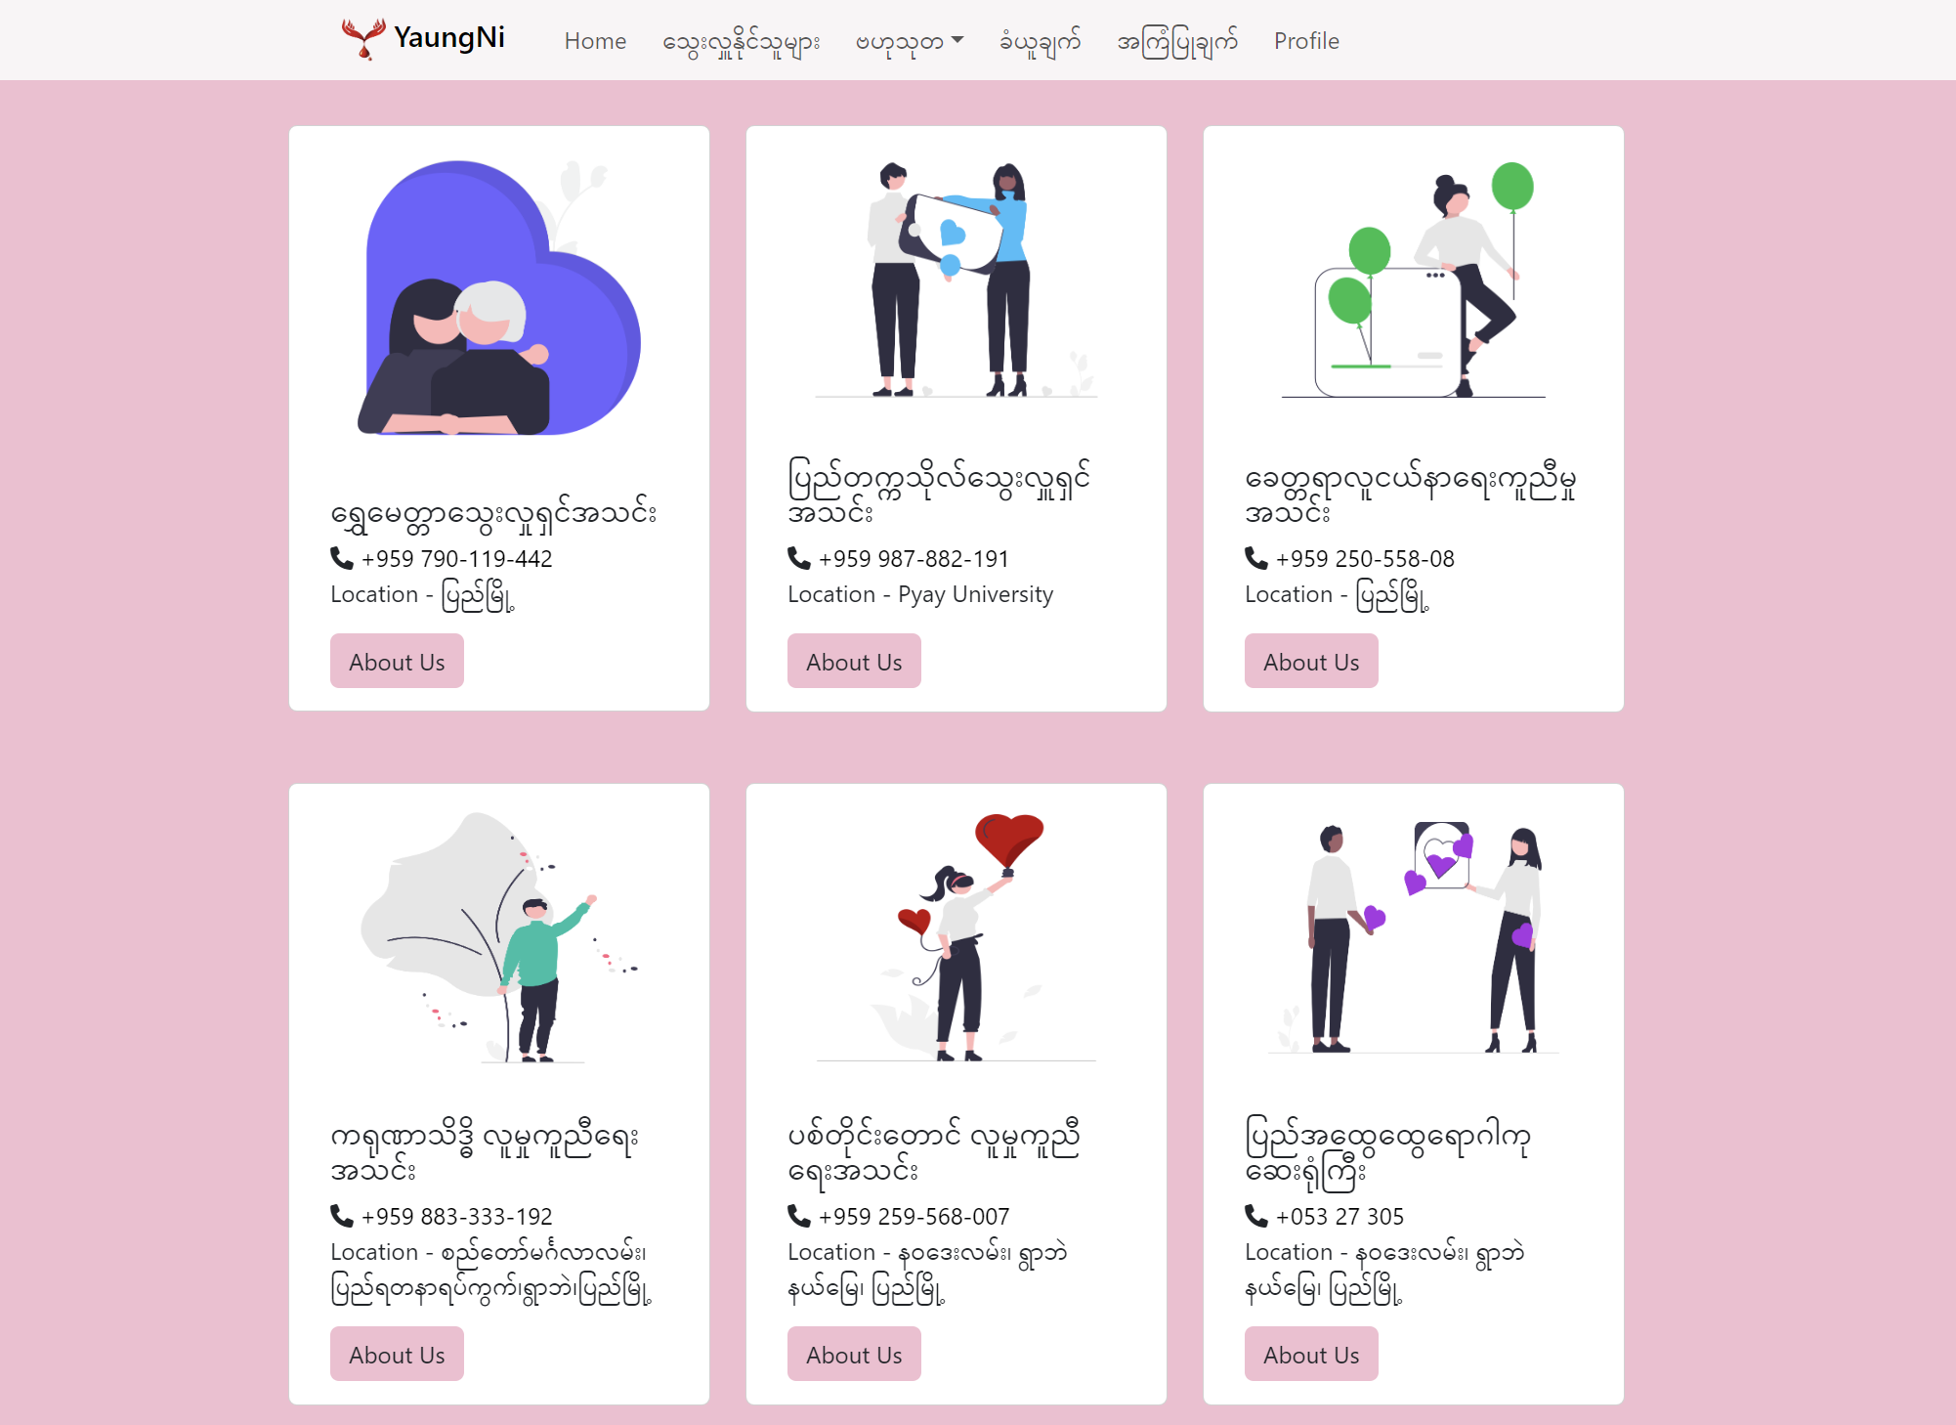
Implementation

Slide 10
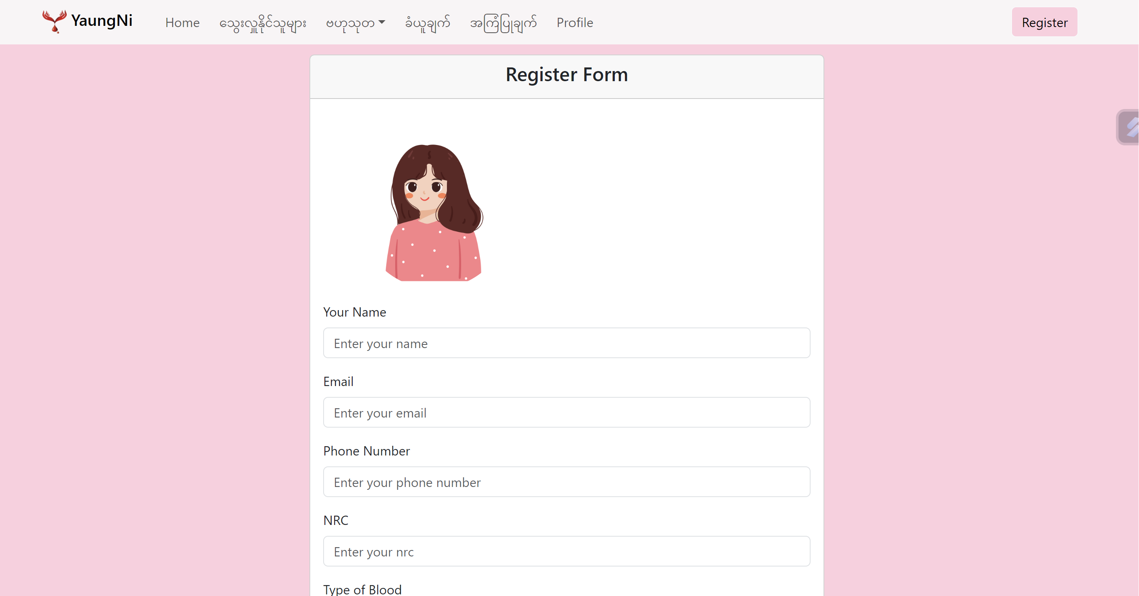
Implementation

Slide 11
Conclusions
Today the world is become a global village where every thing is online.
There are so many web based solutions provided in the market for the comfort of the people.
But without blood human being is non living, just by providing the web solution of blood bank information website is just one more step in order to serve the mankind.

Slide 12
Thanks!
Do you have any questions?
yaungni@gmail.com
+95 9761154409
yaungni.com

